Slide 1

Designing for Active Lives: Contextualising Public Toilet Provision
Gail Ramster & Professor Jo-Anne Bichard
Royal College of Art: Helen Hamlyn Centre for Design

Slide 2
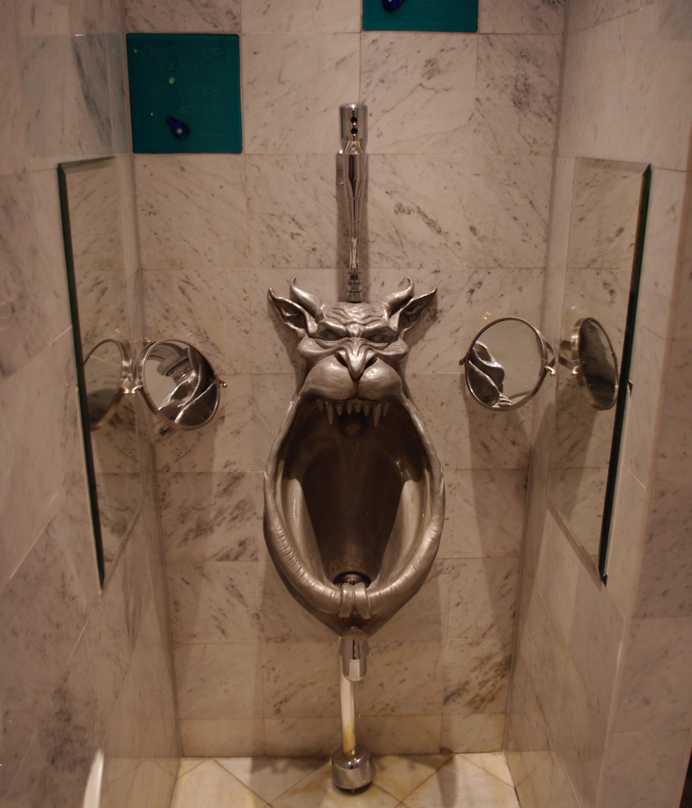
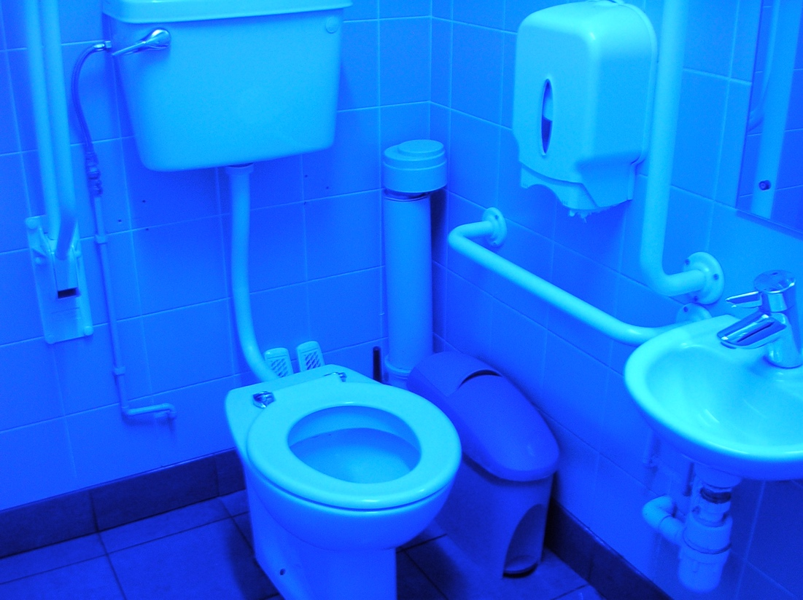
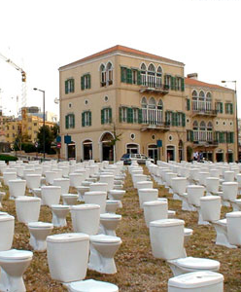
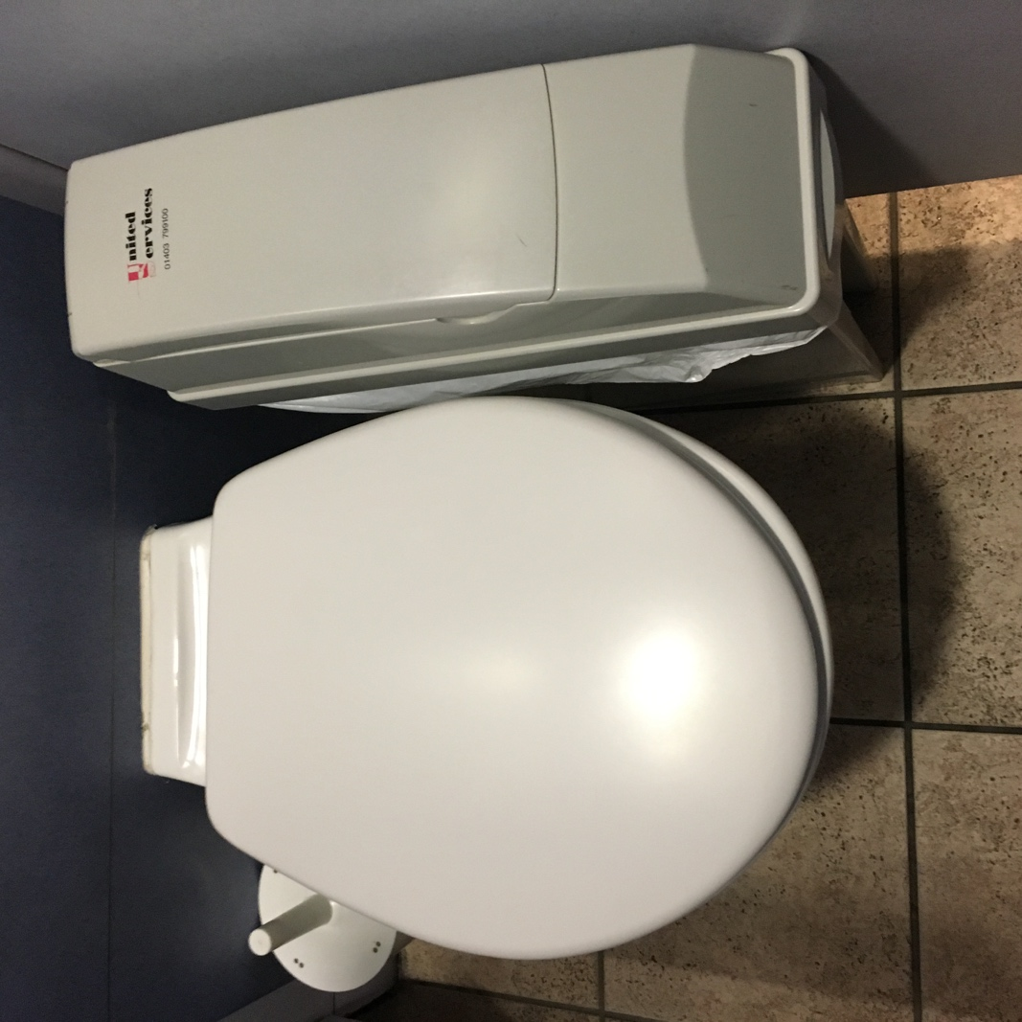
Are Toilets Important?

Slide 3

Are Toilets Important?
Physical aspects of relieving bladder
and bowel ”Normal”
NHS – ideally 4-6 times per day for bladder
NHS – 3 times a day to 3 times a week for bowel
Women more often due to menstruation, pregnancy and menopause
Men more often due to prostate health

Slide 4
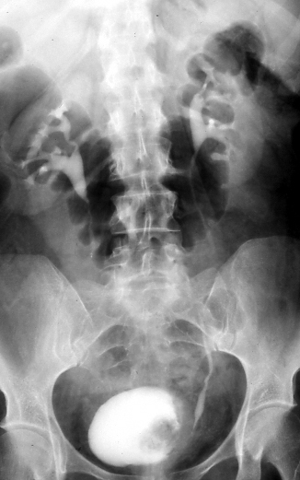
Are Toilets Important?
Physical aspects of relieving bladder
and bowel with a condition
IBS – multiple bowel movements and urgency to reach toilets
17% of UK population
11% Men
23% Women

Slide 5
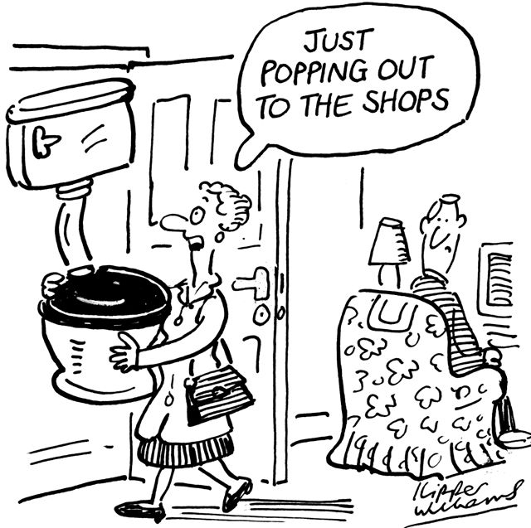
Are Toilets Important?
Physical aspects of relieving bladder
and bowel due to medication
High Blood Pressure/ Diuretics
I in 4 UK adults (12.5 Million)
31% Men
26% Women
4 million people on anti-depressants
48% of UK population on medication
24% on more then 1 medication

Slide 6
Are Toilets Important?
Physical aspects of relieving bladder and bowel due to age
Toddlers urinate 4-8 times a day
Older people – increased bladder frequency
Need to use toilets more often
Weakening bladder muscles
Urgency

Slide 7
Are Toilets Important?
Royal Society for Public Health (2019)
Lack of toilets is “affecting equality, mobility, physical fitness and other aspects of health”
Access to toilets when outside of the home is a necessity for living active lives

Slide 8
What makes a good toilet for active living?
Cleanliness

Slide 9

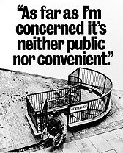
What makes a good toilet for active living?
Accessible
British Standards – 50 design features
Audited 101 toilets in England
Not one featured all 50 recommended features
Highest score 32 features
Failure to adhere to recommendations can make toilets inaccessible to users

Slide 10
What makes a good toilet for active living?
Available
Provision is fragmented
Public and private providers
Different initiatives for extending provision
Community Toilet Schemes
Can cause confusion for users – whose in whose out?
GBPTM

Slide 11
The Great British Public Toilet Map
A map for all ‘publicly accessible toilets’
‘Any toilet the public can use without being ‘a customer’

Slide 12
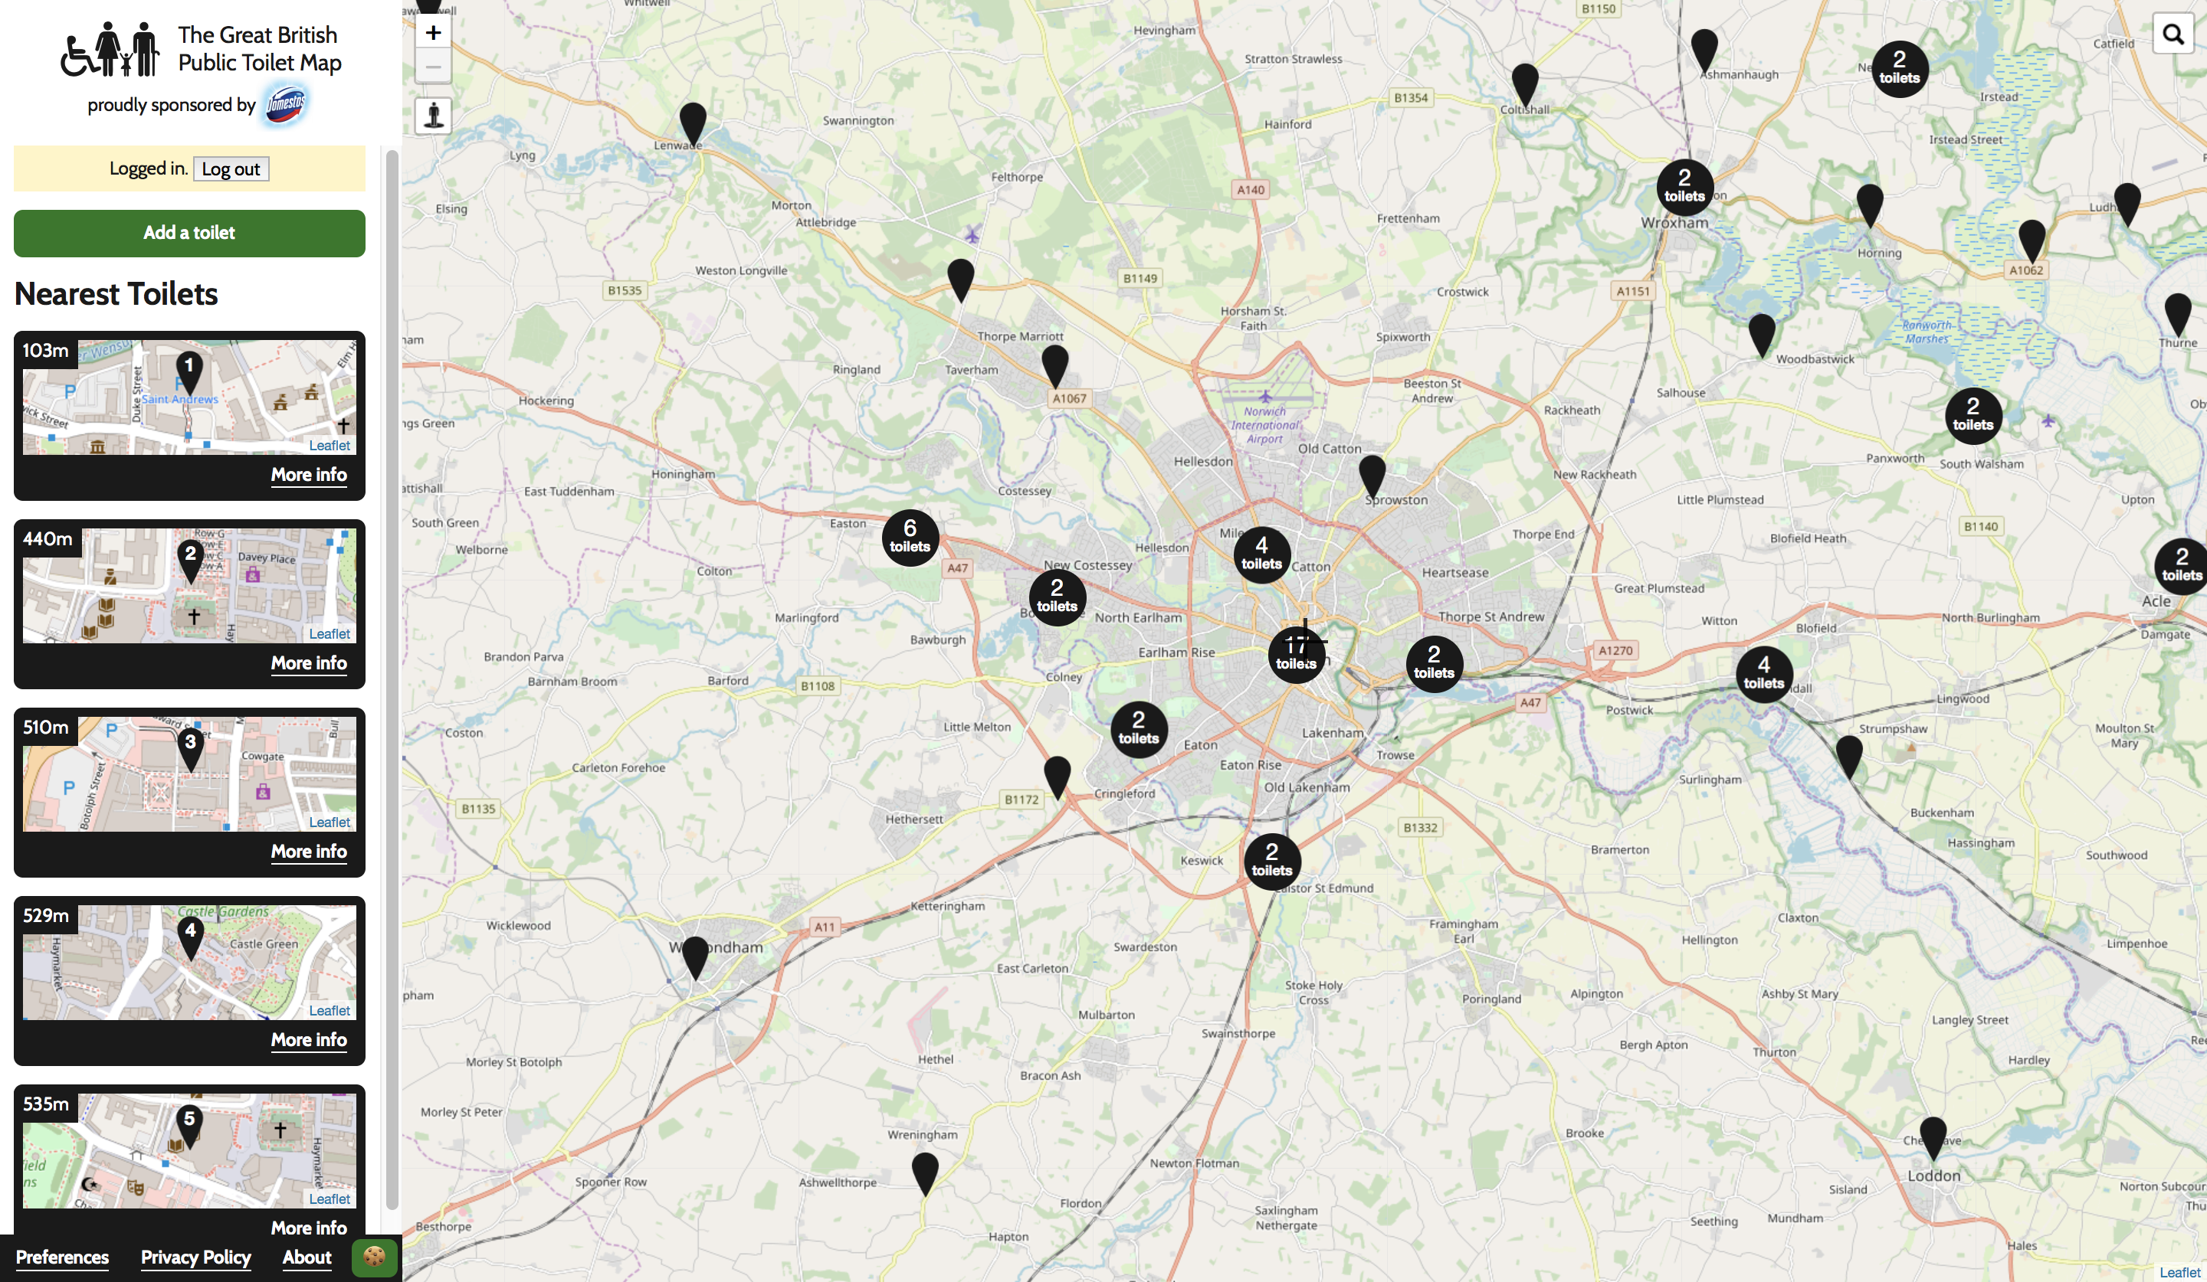
Notes:
Than you Jo-Anne.

Slide 13
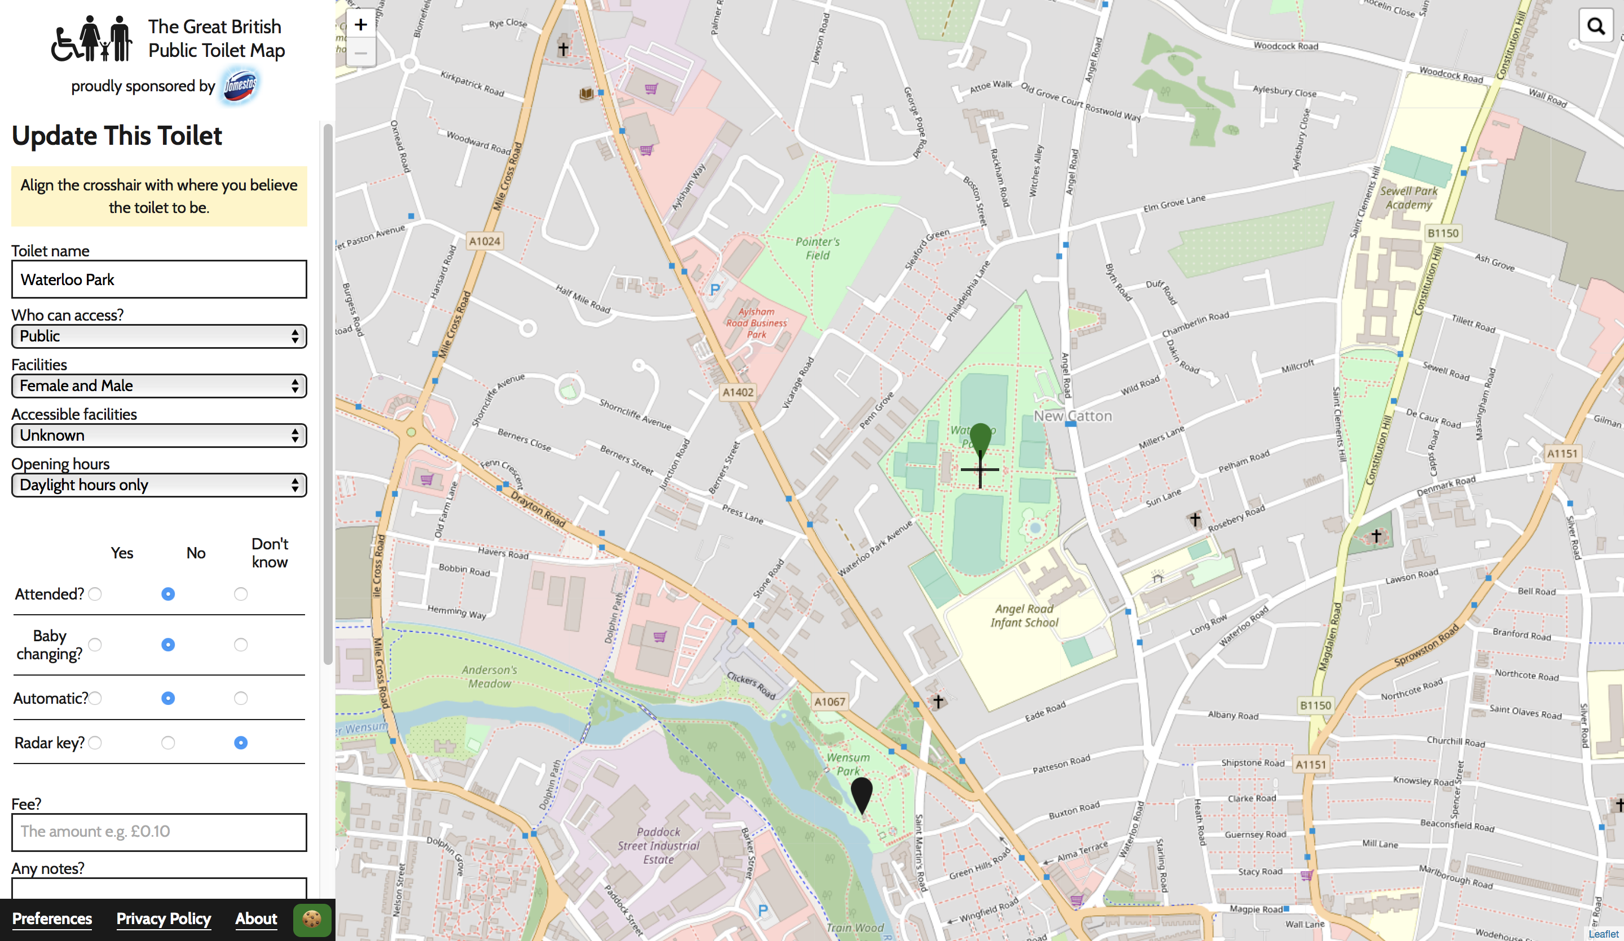
Notes:
Than you Jo-Anne.

Slide 14
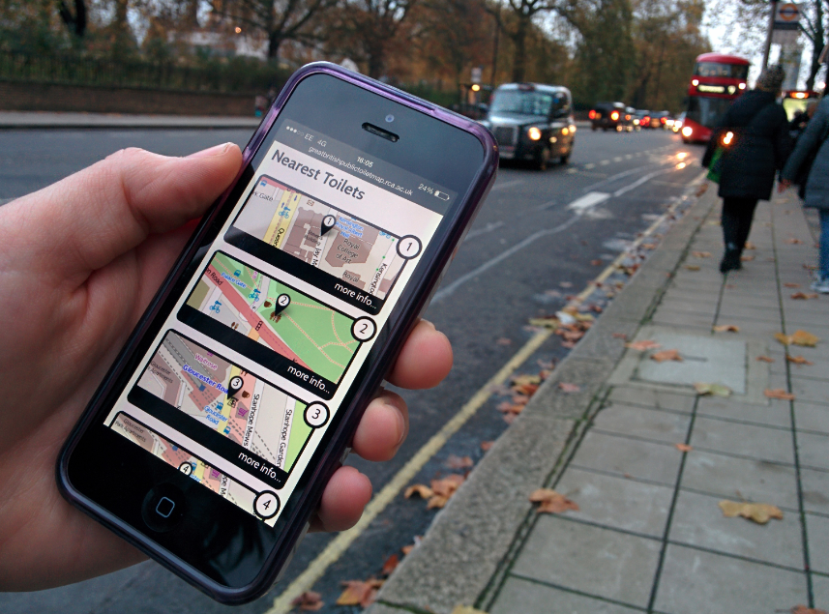
Notes:
Than you Jo-Anne.

Slide 15
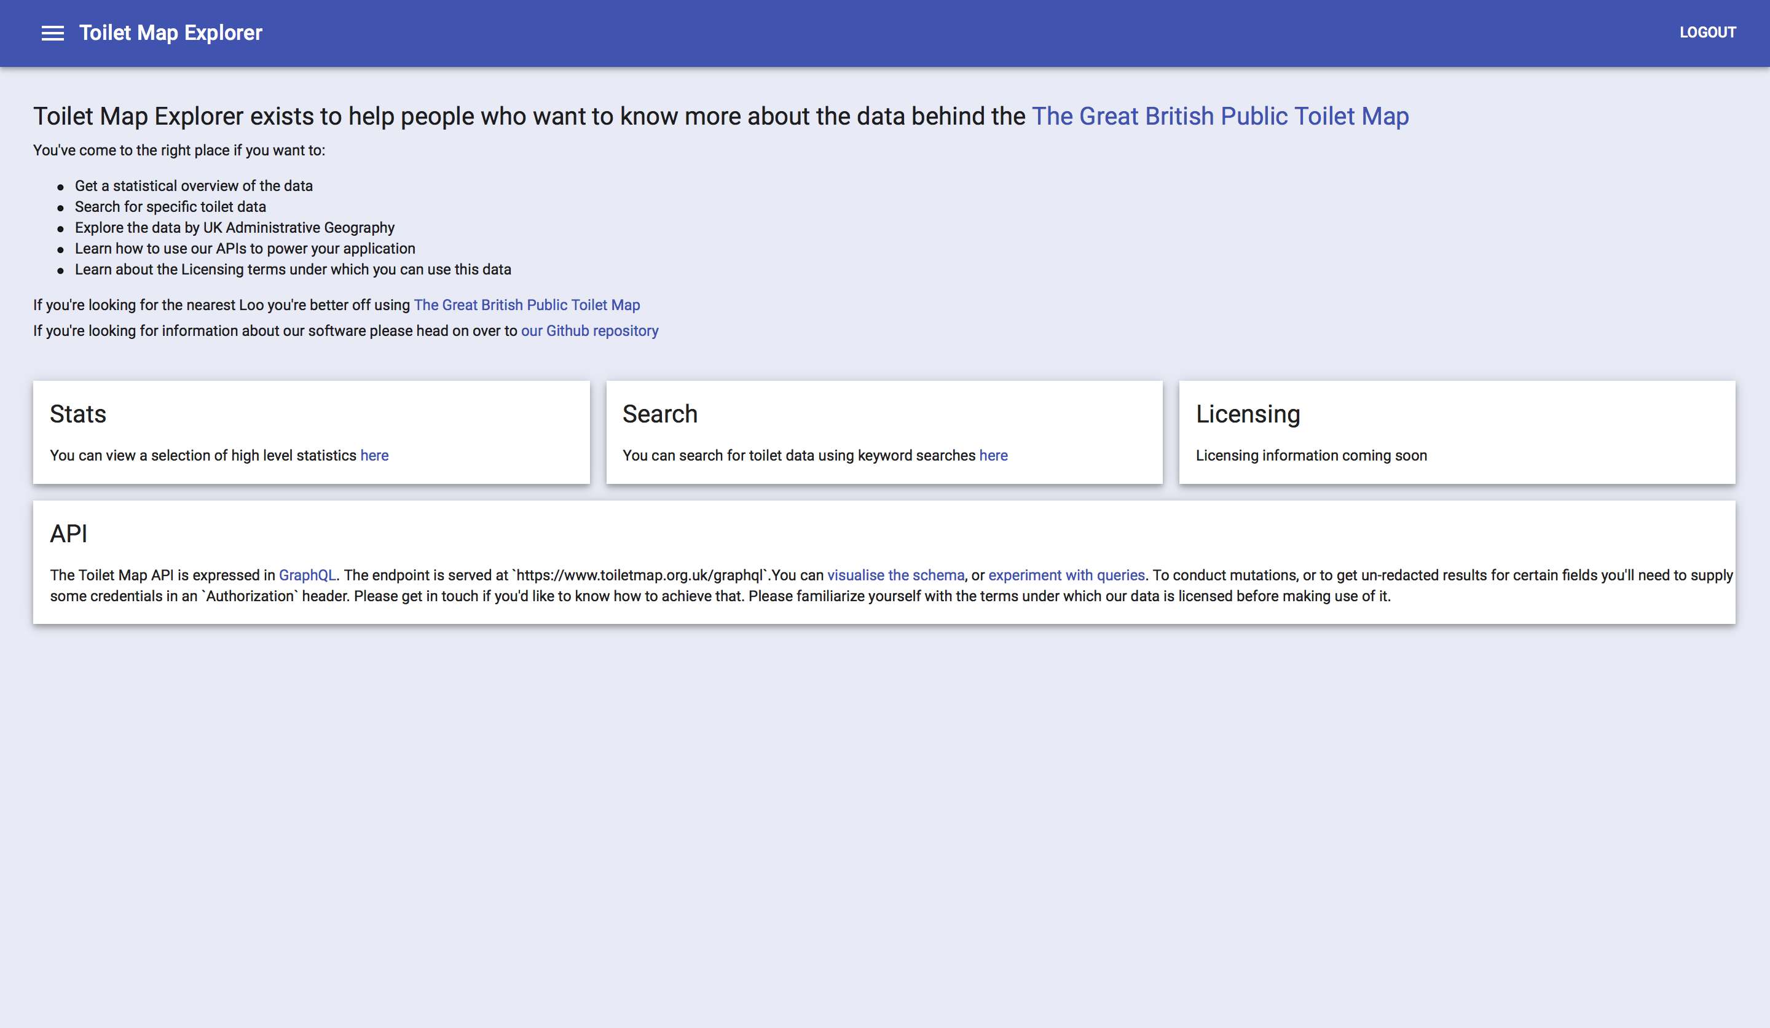
Notes:
Than you Jo-Anne.

Slide 16
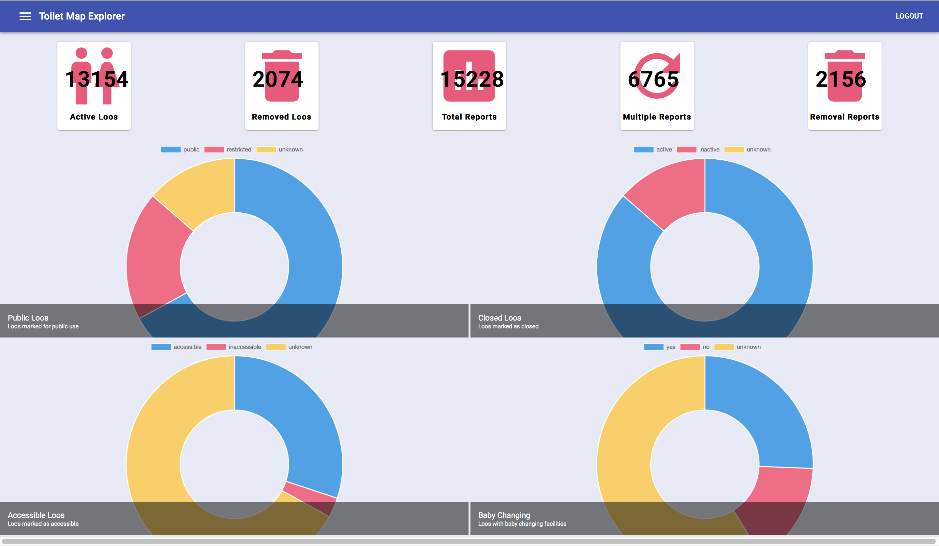
Notes:
Than you Jo-Anne.

Slide 17
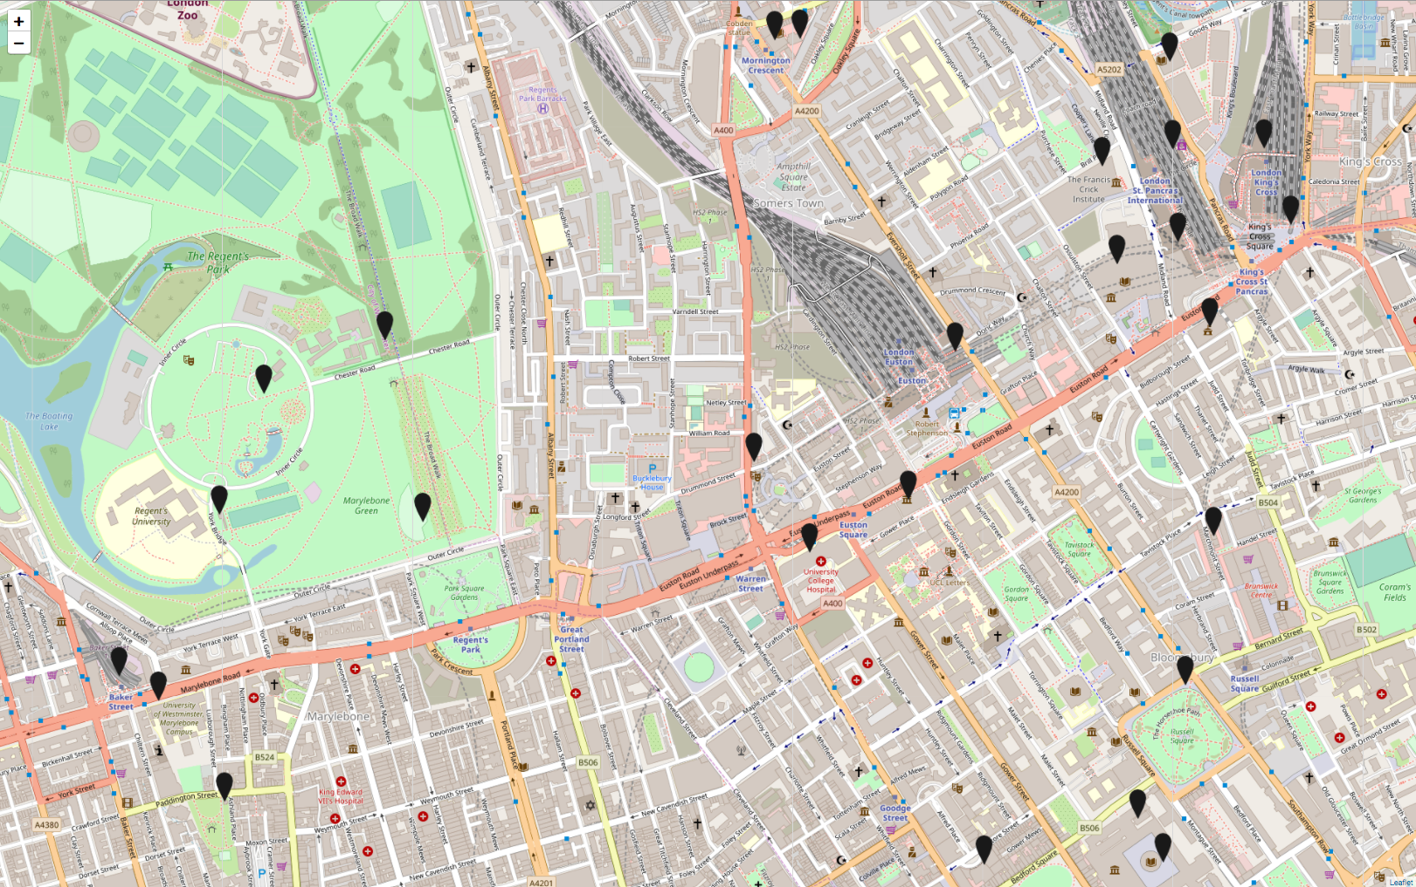
The Great British Public Toilet Map
A map for all ‘publicly accessible toilets’
‘Any toilet the public can use without being ‘a customer’.
Notes:
To show you the map data that we hold, I’m going to use our location here at the RC of P – the red star. There are 26 publicly accessible toilets in this image.
But what do we consider a PAT?

Slide 18
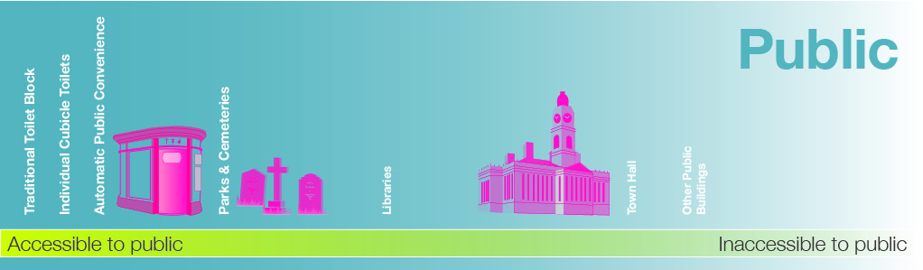
What are Publicly Accessible Toilets?
Notes:
Public toilets are not simply a yes/no, and everyone will define them different.
I consider it more of a spectrum of how much of society would feel welcome and permitted to access the facilities.
For example, toilets within public-owned buildings and spaces might include Public Toilet blocks and APCs/Superloos – along with those in parks and cemeteries being at the highly accessible end of the scale –
through to libraries in the middle, which everyone normally feels welcome in so why not use the loo too…
then at the more inaccessible end, or exclusionary, the town hall – public in name but very few will have gone inside –
and other public buildings such as leisure centres, hospitals, where they’re not really there to be community spaces, and may be privately run, may or may locate the toilet in beyond the entrance, in areas reserved for customers in the case of the leisure centre, are these still public services?
In fact the very idea of having to pay for a traditional public toilet can make them feel exclusive to those who cannot afford them, so in some ways the most public of toilets can still exclude.

Slide 19
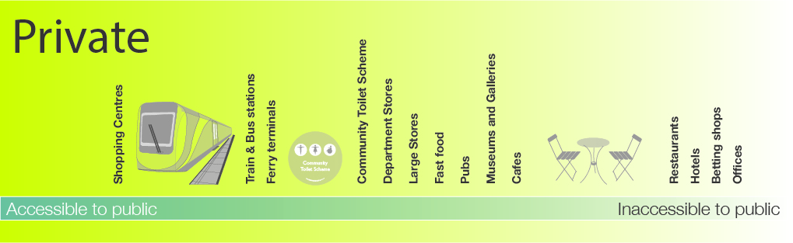
Notes:
And then there are all the publicly accessible facilities that are actually privately owned.
Shopping centres, transport hubs, these are places that we consider in may ways as public spaces, where we have, rightly or wrongly, a right of access, and well populated spaces frequented by many people, and not just local people, so we have anonymity.
Transport is positioned a bit lower as sometimes toilets can be beyond the gateline.
Then we get into retail – community toilet schemes…
Dept stores, large stores such as supermarkets, retail parks,
Macdonalds, Pubs I’ve rated lower despite many of us sneaking into pubs without being a customer, as many also don’t feel comfortable going into pubs, whether because they don’t go in places that sell alcohol, or they don’t look like the customer, or children are not allowed.
Museums and galleries - If it’s a free museum then who’s to say no to you using the toilet and possibly appreciating some artefacts…
At the lower end – cafes and restaurants not in community toilet schemes – a lot harder to waltz in. Hotels, no the way I’m dressed. Betting shops – apparently tend to have toilets – but not many are comfortable going inside.
Offices at the end.
Even then what have I missed? Service stations? Petrol stations? Coffee shops? Garden centres?

Slide 20
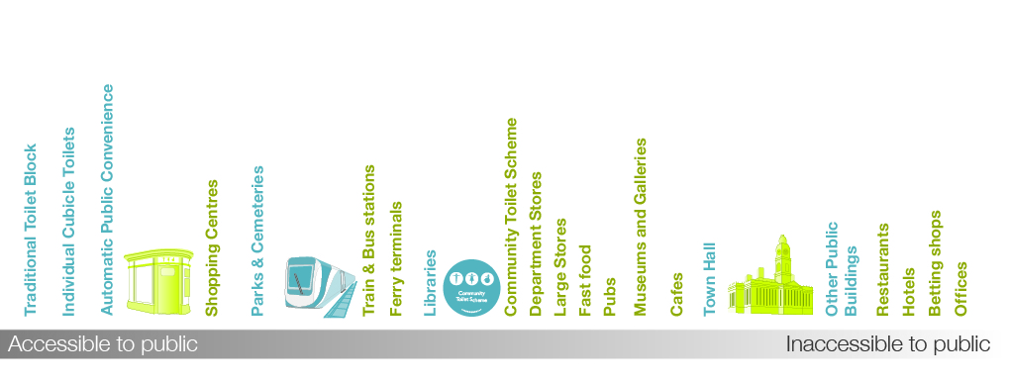
Publicly Accessible Toilets
Included on Great British Public Toilet Map
Notes:
And this is how these two spectrums combine, so you can see how private spaces can be great providers of publicly accessible toilets, public spaces can be unwelcoming, and there’s no such thing as a public toilet. What would also interesting I think is run this activity with a broad range of the public – teenagers, homeless people, mobile workers, people with continence conditions, people from different cultures or demographics, disabled people – this is just my best guess, but how do others perceive the public realm?
In green I’ve shown which we choose to show on GBPTM – either data we’ve added, or data where if someone else adds it we won’t take it off - and where we try to draw the line – so we prioritise the left hand side, we prioritise public providers and we show retailers only if there are very big stores (anonymity), or part of a Community Toilet Scheme. So it’s not necessarily about not being a customer, it’s about not having to, or needed to ask permission.

Slide 21
Public Toilet
Train / Tube Station
Community Toilet Scheme
Public Building
Cultural Institute
Hospital
Notes:
An example - who provides the 26 toilets around the area?
Public toilets – even here – 3 providers. Royal Parks, City of Westminster, Camden Council.

Slide 22
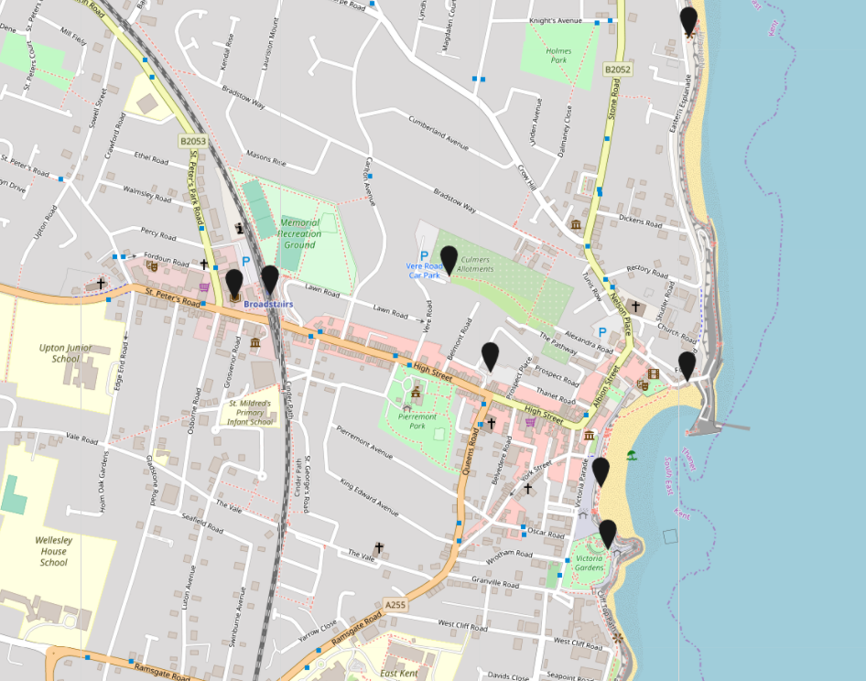
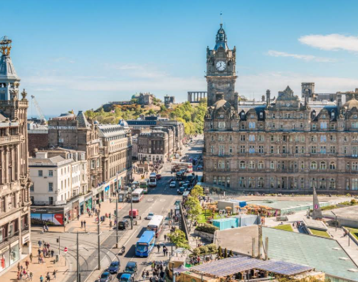
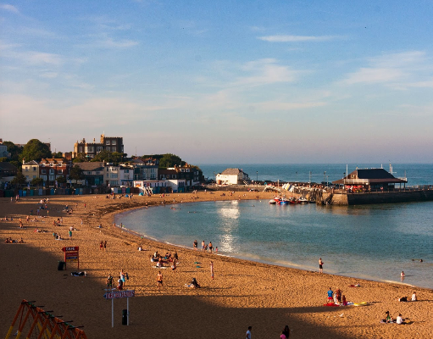
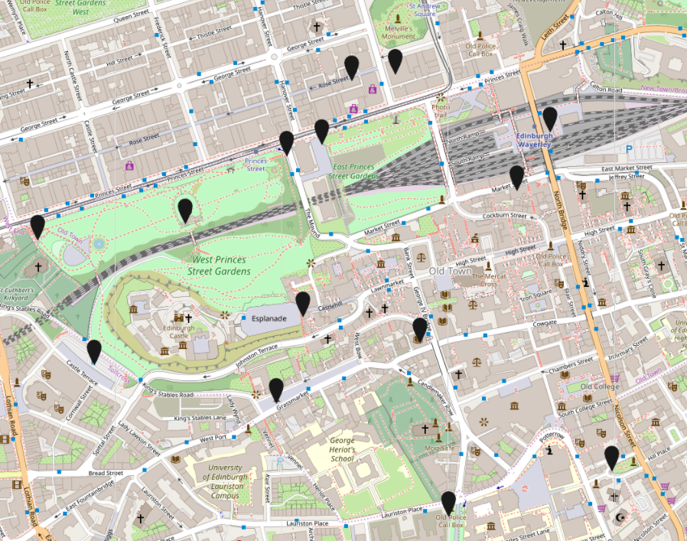
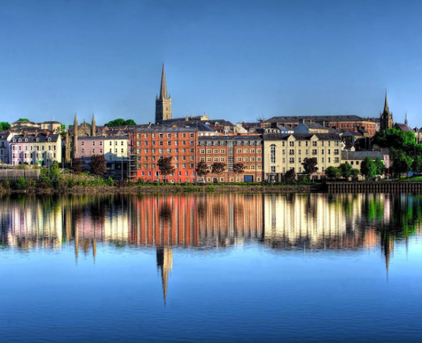
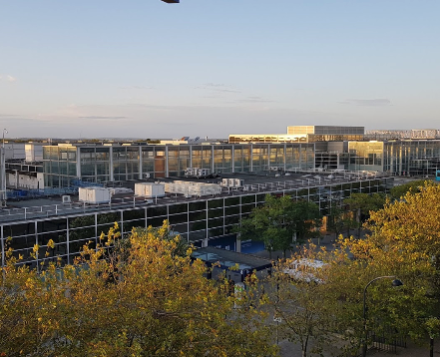
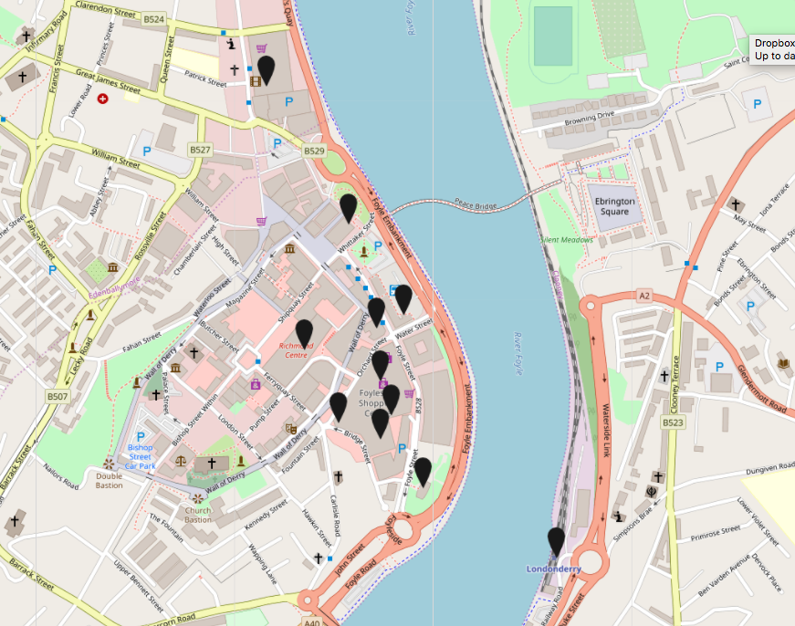
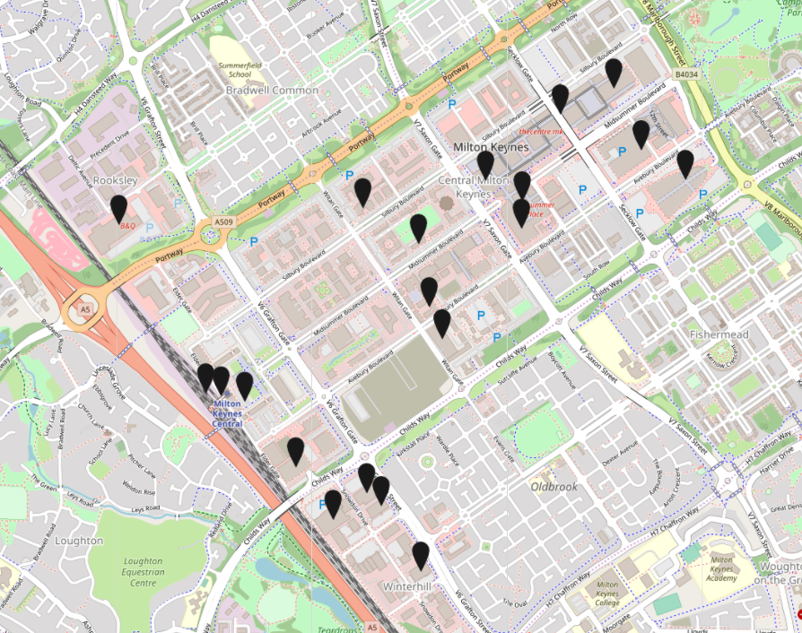
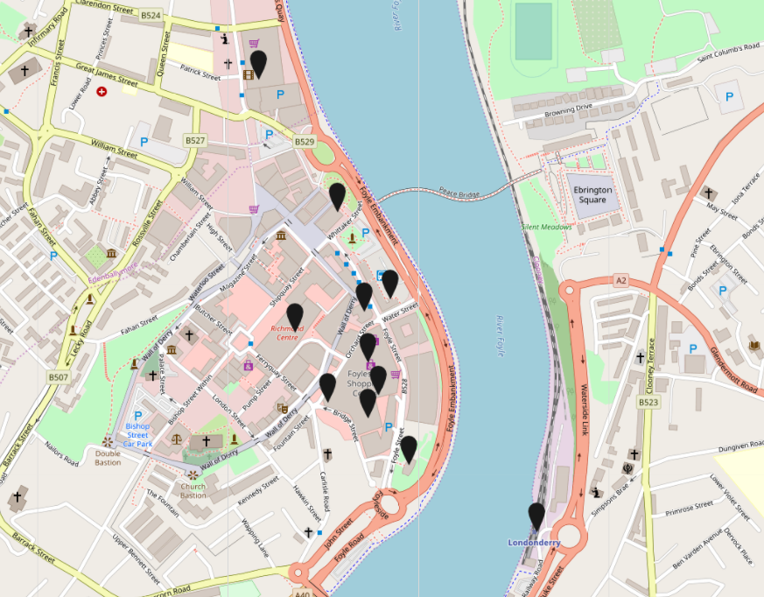
Public Toilet
BROADSTAIRS
EDINBURGH
Train / Tube Station
Public Building
Community Toilet Scheme
Large Store
LONDONDERRY
DERRY
MILTON KEYNES
Shopping Centre
Cultural Institute
Hospital
Notes:
Broadstairs in Kent
Londonderry / Derry Northern Ireland – small city – quite mixed provision, but not based on public toilets.
Edinburgh – capital city
Milton Keynes – a famous new town.
At first glance a good levels of facilities, each one using very different make up of provision.

Slide 23
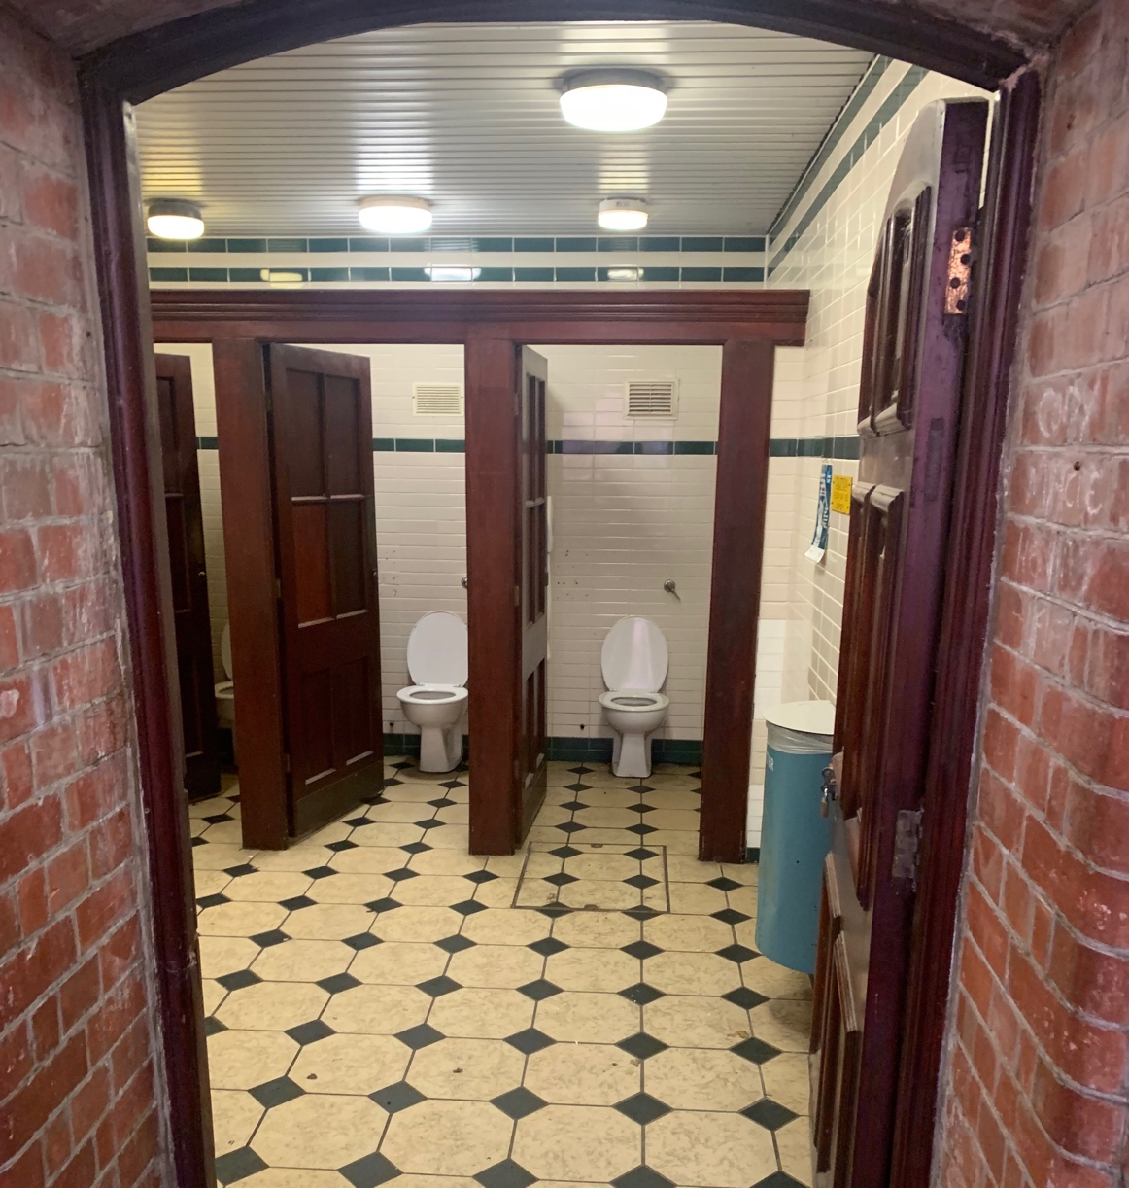
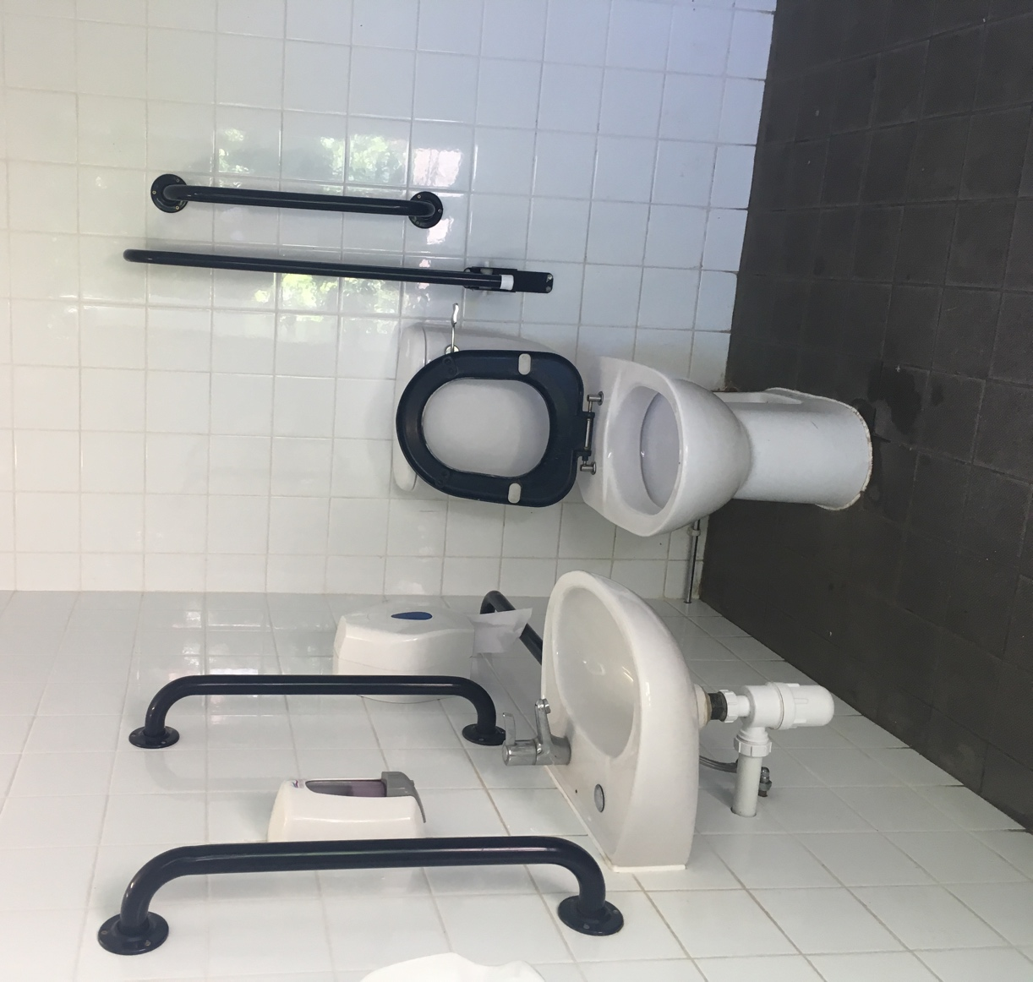
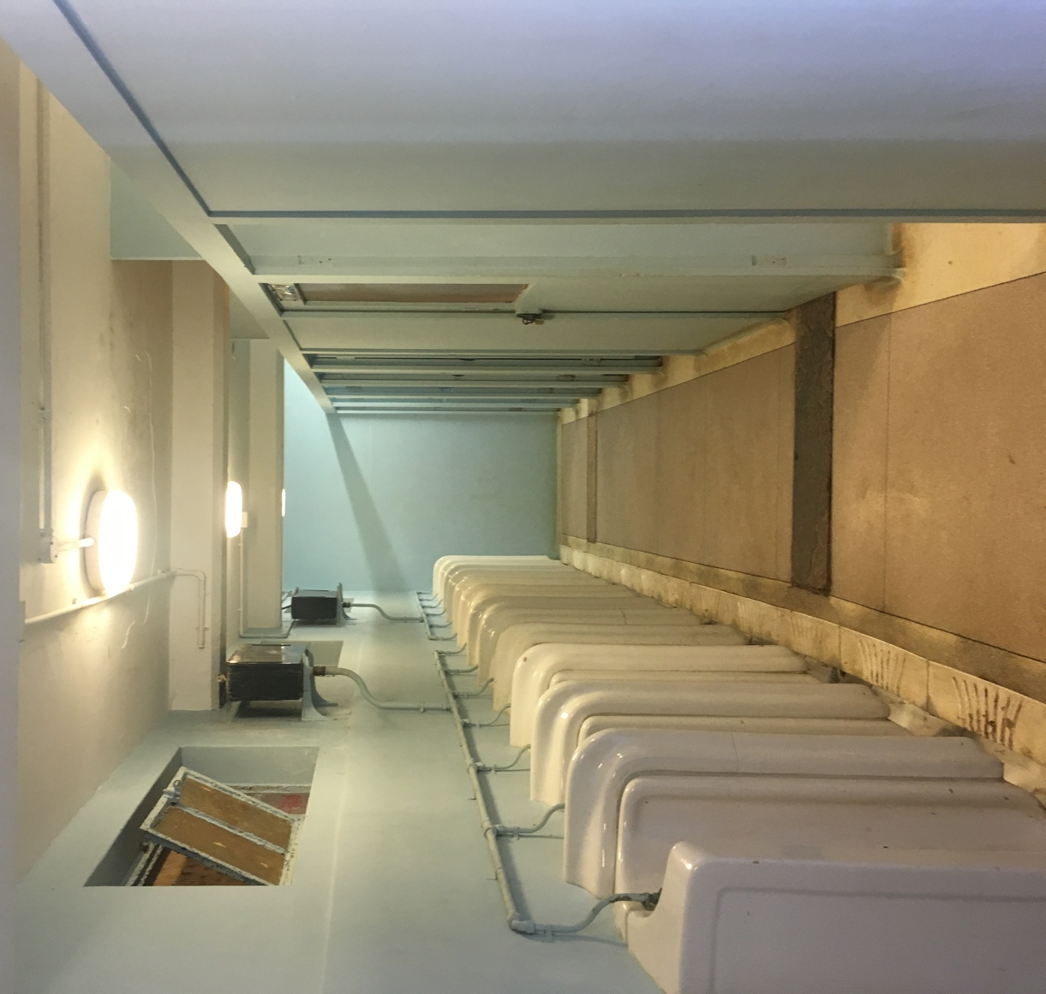
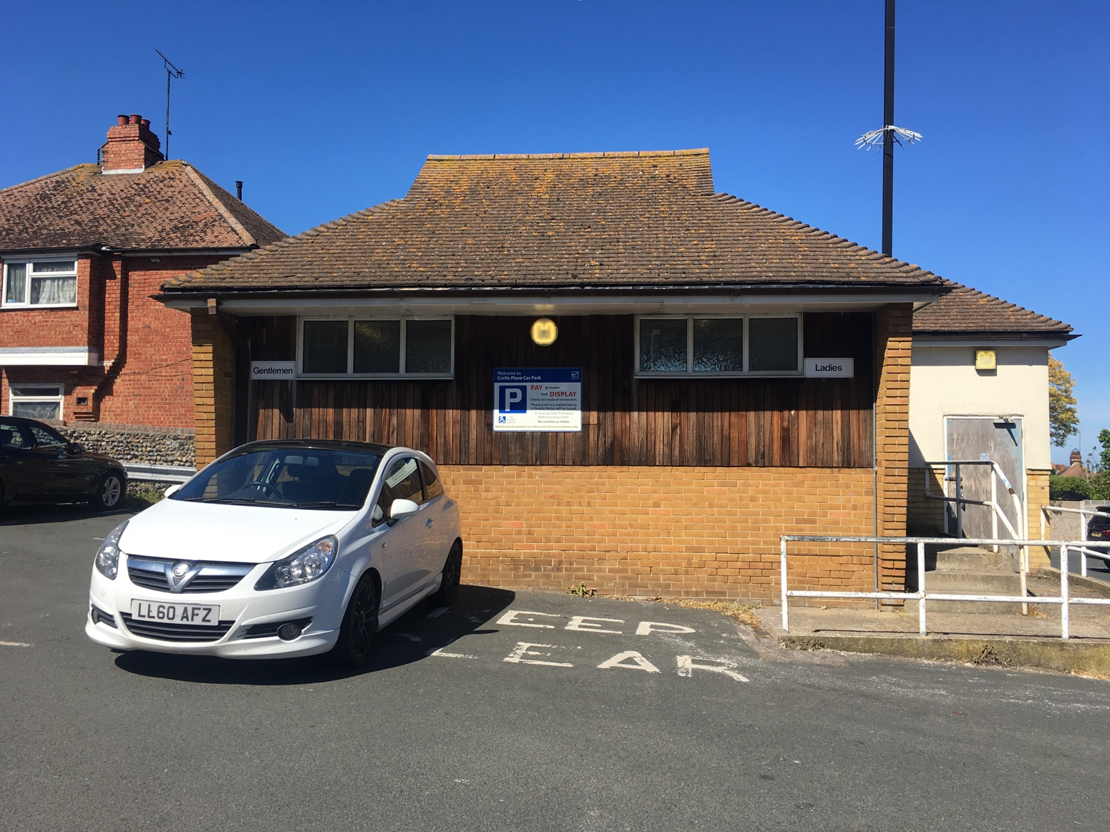
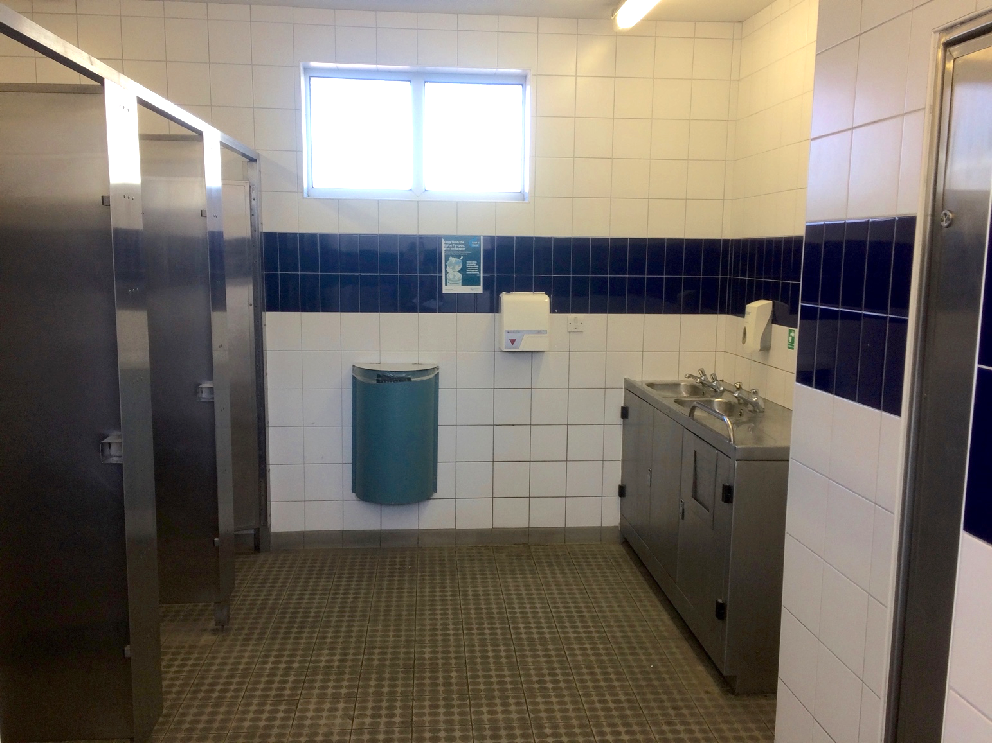
City centre toilets
Public already relying on private providers
Multiple providers (e.g. shopping centre, bus station, department store)
Present as joined up provision, cover most hours.
Expand with community toilet scheme.
Notes:
People already using private toilets as expect them to exist, and expect them to be clean.
Make sure they are accessible, and inclusive.
High quality information about what is, and fill the gaps if there are gaps in provision.

Slide 24
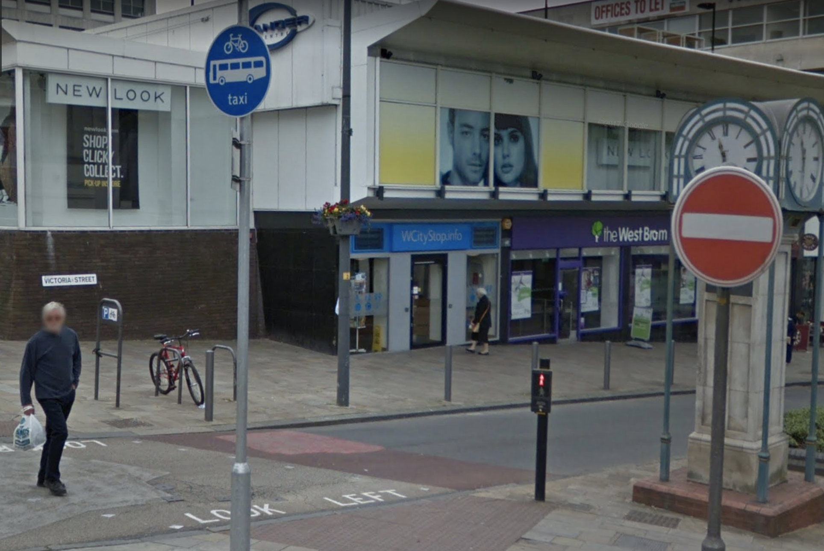
Example: WCityStop.info, Wolverhampton
Notes:
e.g. WCityStop.info in W’ton
In an unused shop.
Has trained toilet attendants who work on a reception, to help.
Free, so everyone feels able to access, won’t be turned away.
Multiple use – portal to access council services, pick up leaflets, display screens with resident information
Has been used at night time too

Slide 25
Park toilet
Dedicated public toilet
Accessible, inclusive
Functional & clean
Safe – preferably attended
Free
Robust
Notes:
Royal Parks – attended toilets to reduced vandalism and keep clean. However a considerably expense when it’s middle of winter.

Slide 26
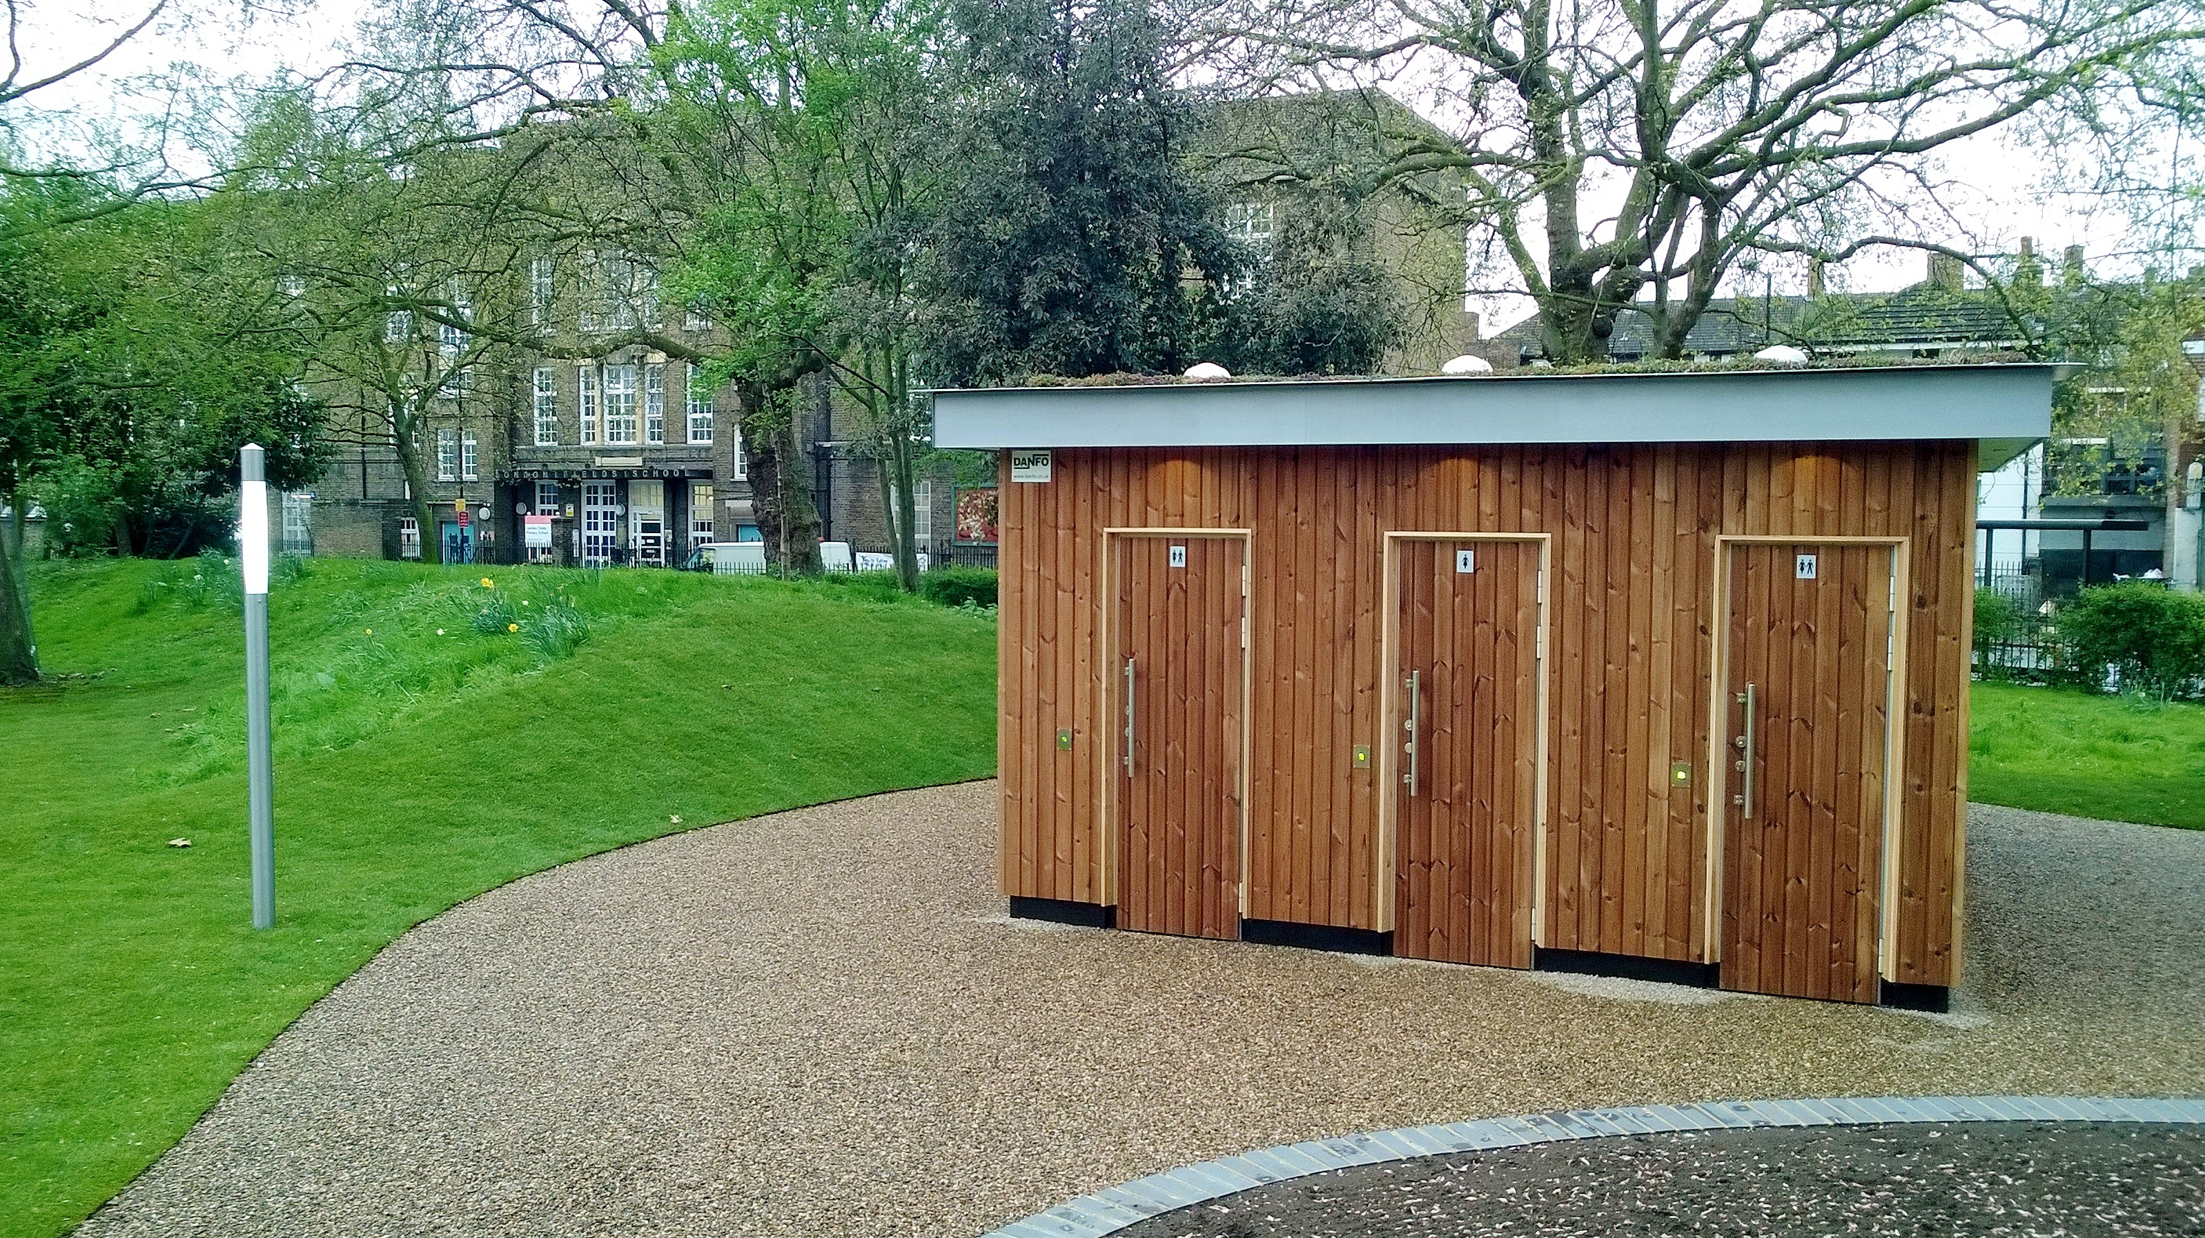
Example: London Fields
Notes:
Royal Parks – attended toilets to reduced vandalism and keep clean. However a considerably expense when it’s middle of winter.

Slide 27
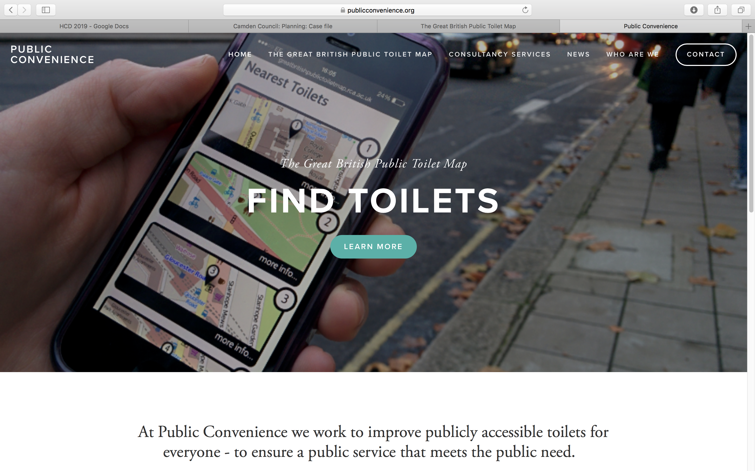
Notes:
Public Convenience – consultancy services for local authorities, private providers, cultural venues, including accessibility advice and audits, alternative models for provision and inclusive design guidance amongst other things.

Slide 28
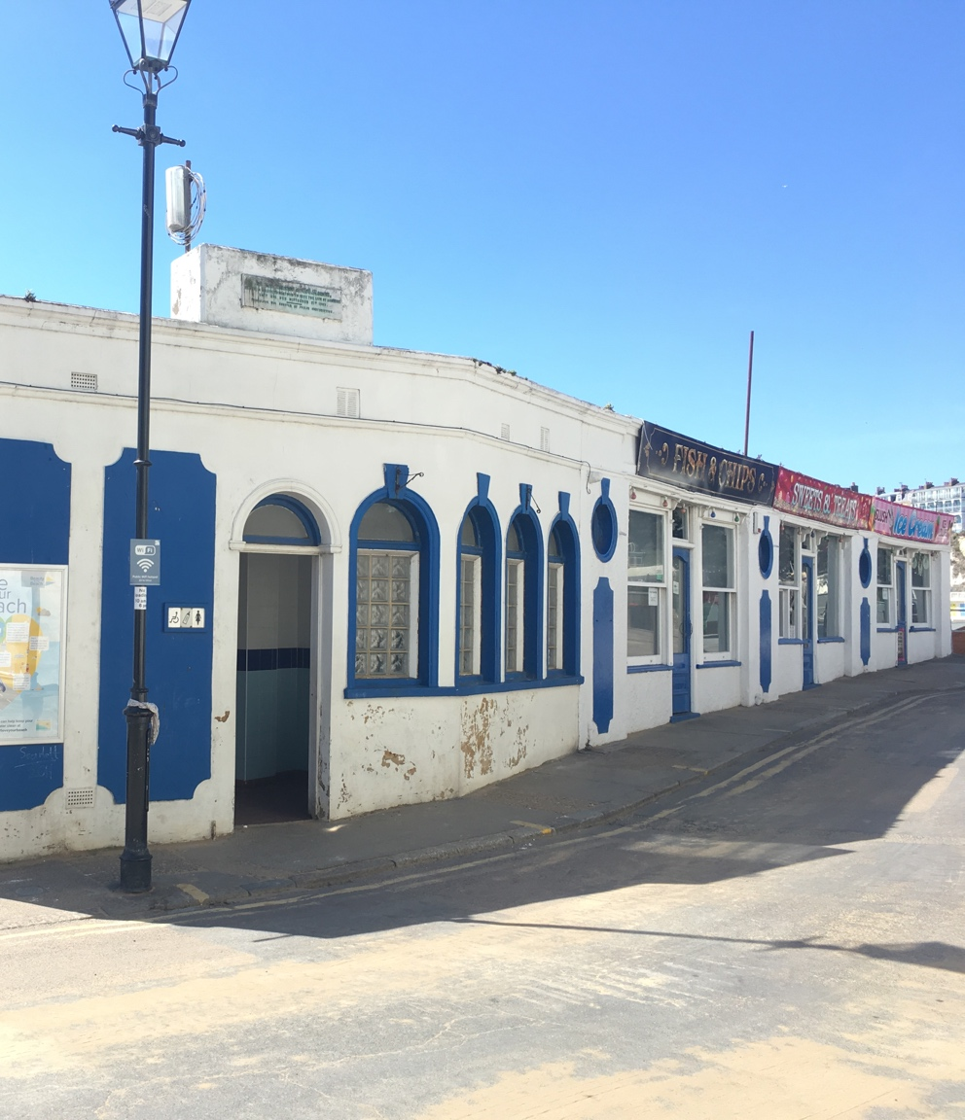
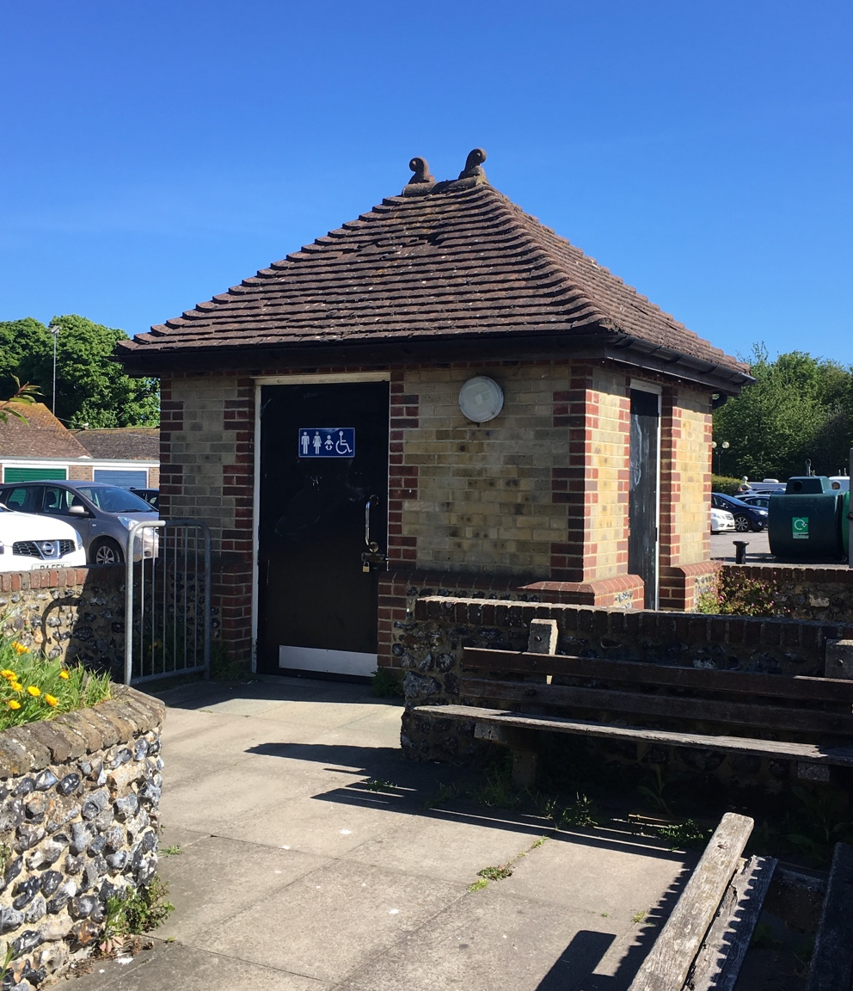
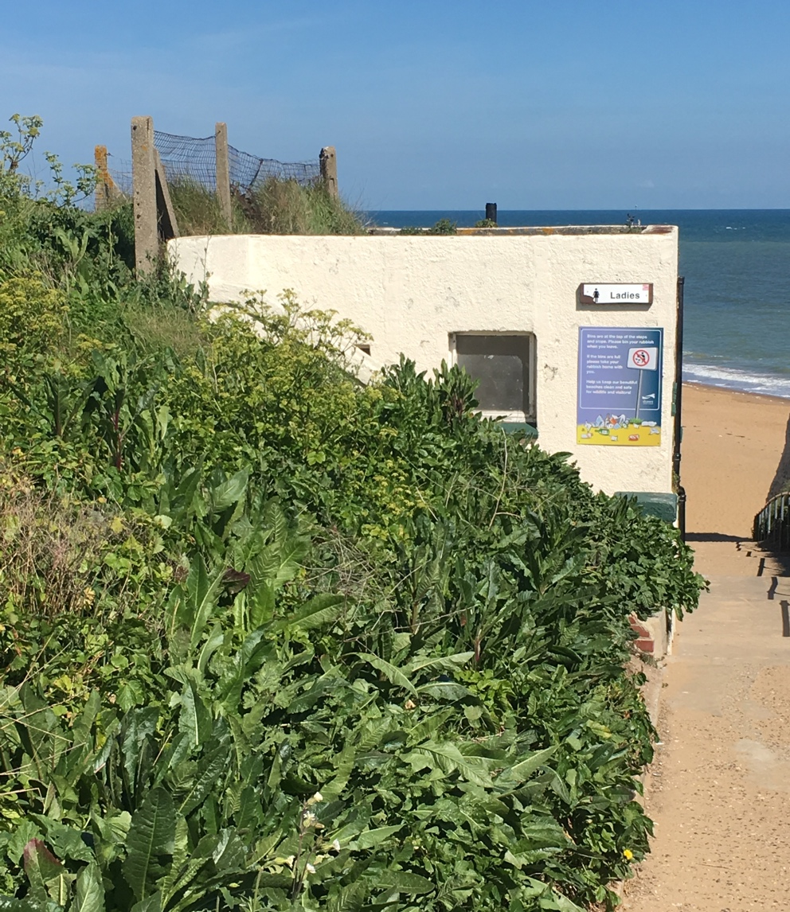
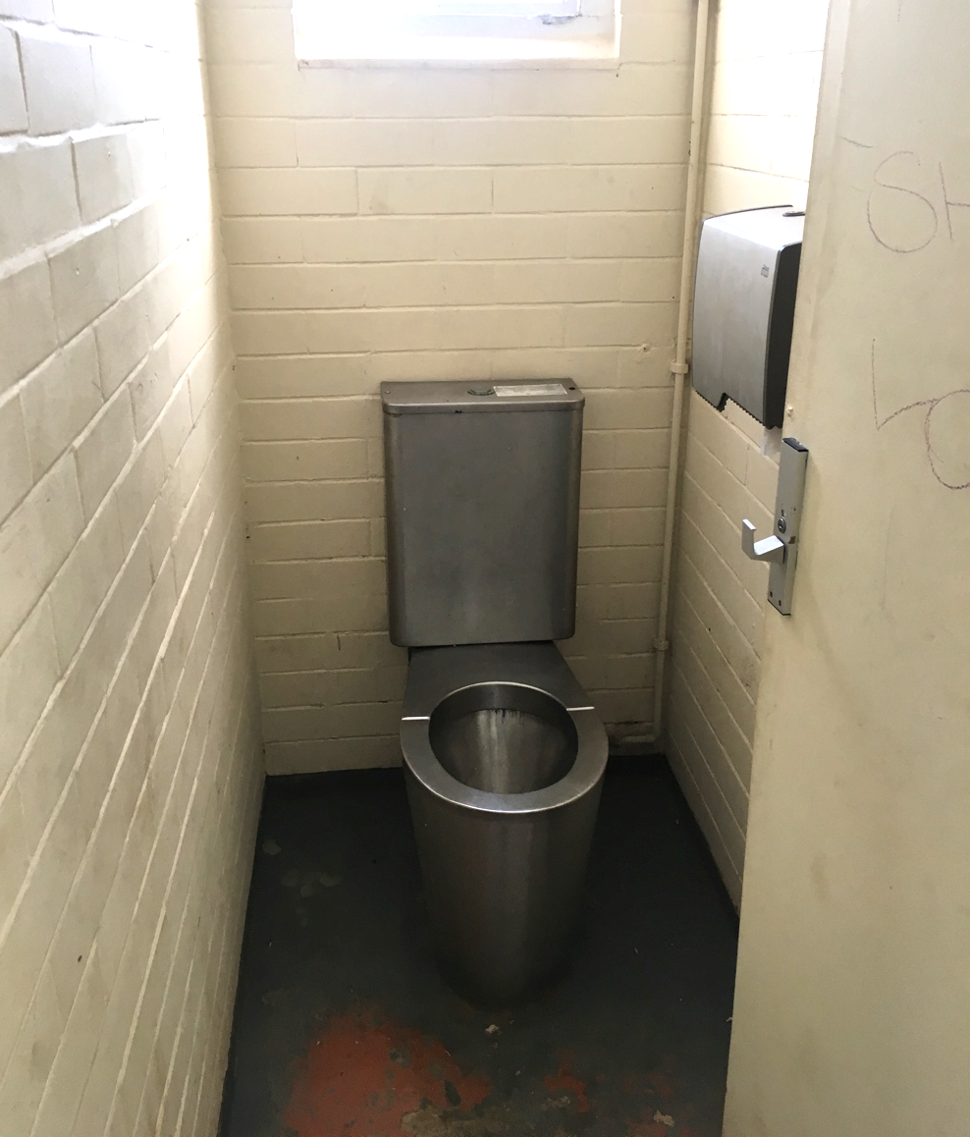
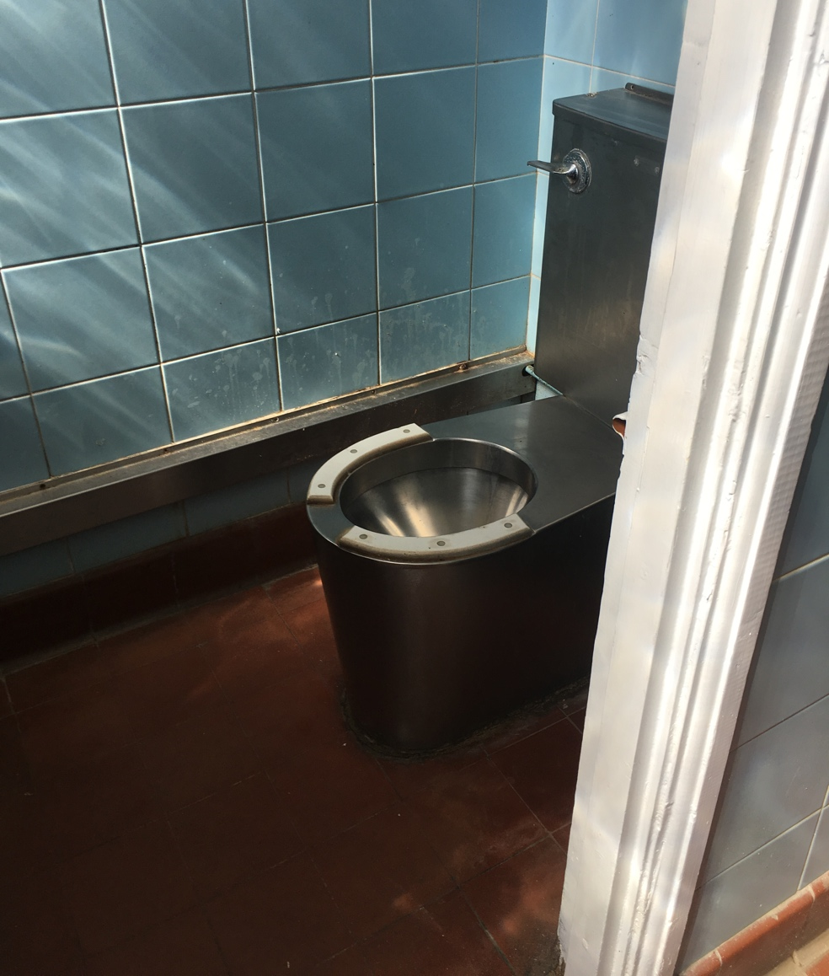
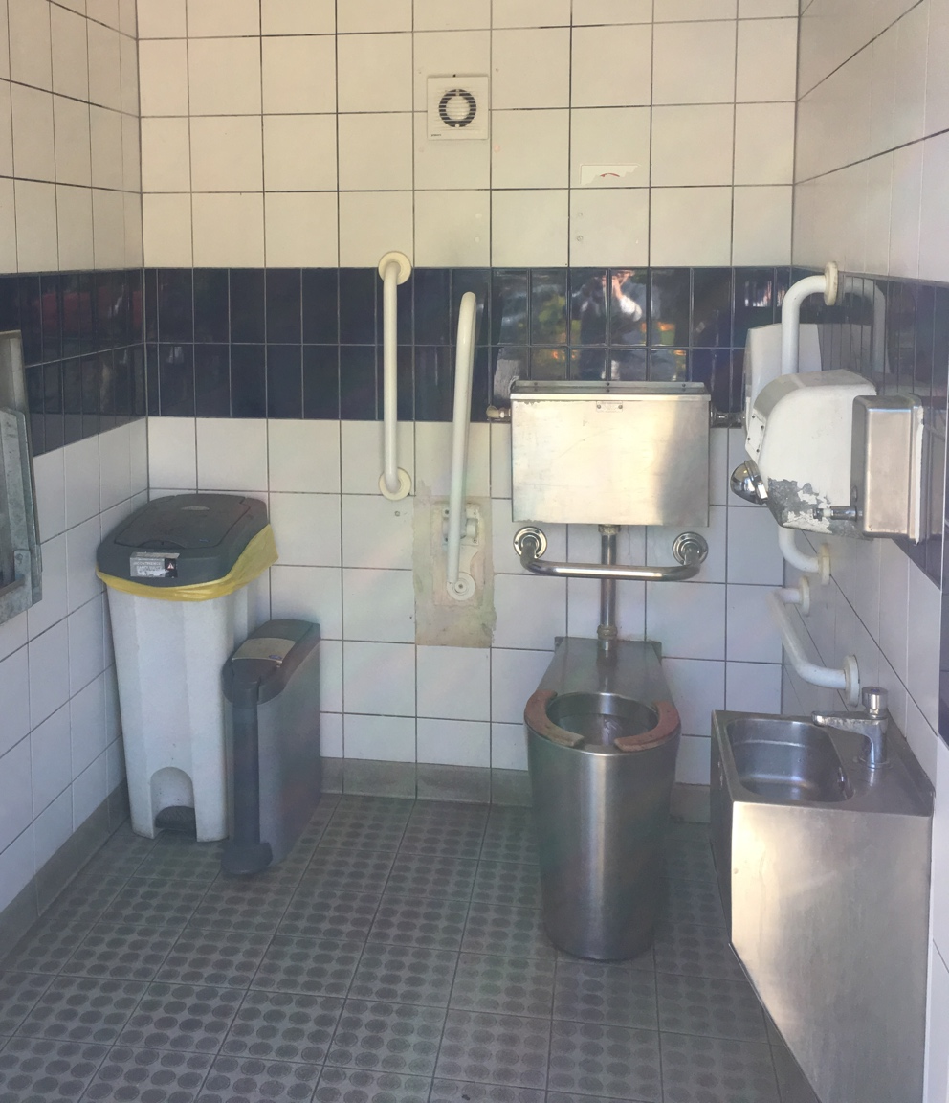

Slide 29
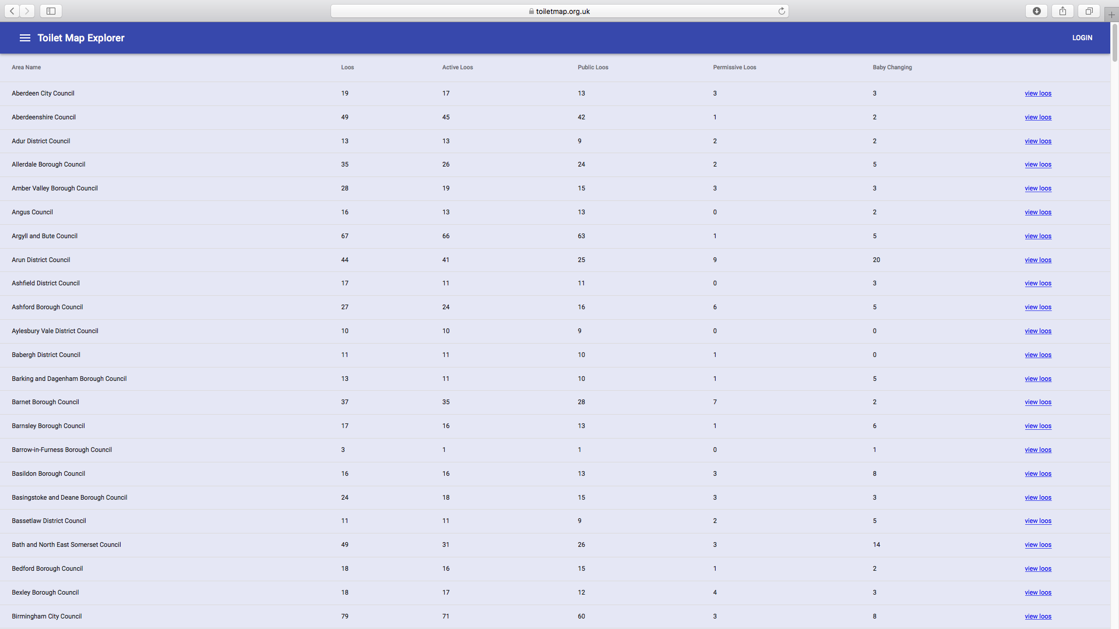
Council Analysis

Slide 30
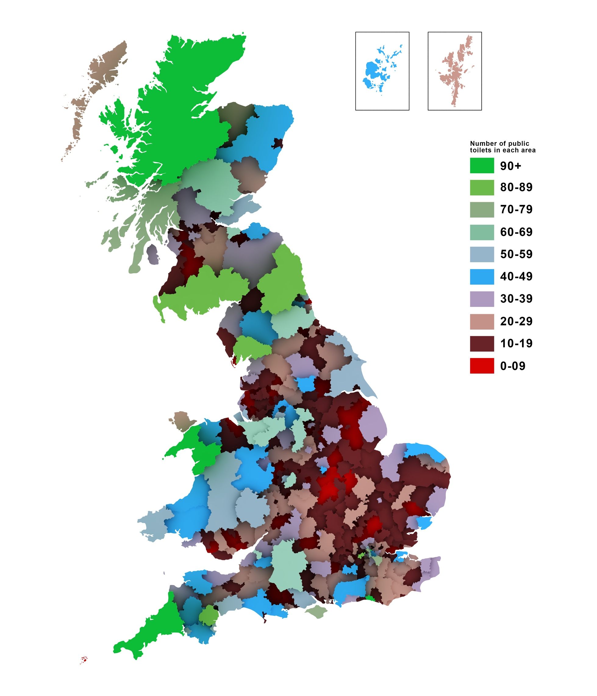
Council Analysis
Large councils of natural interest
Councils with strong CTS
Most toilets:
Fewest toilets:
Cornwall (203)
Highlands (191)
City of London (108)
Flintshire (4)
South Ribble (4)
North Kesteven (4)
2016 GBPTM data

Slide 31
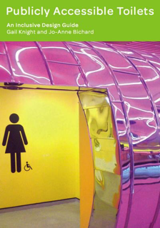
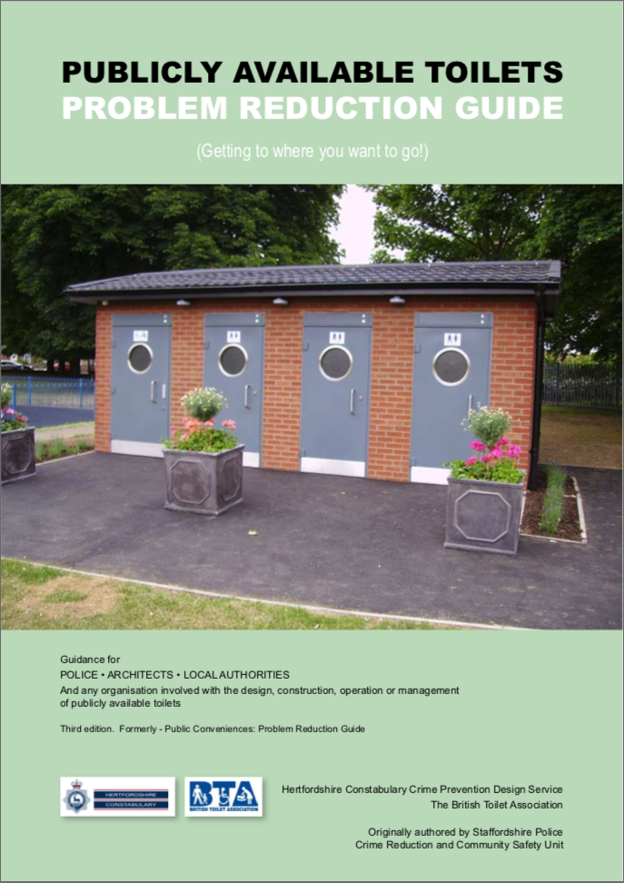
Where to find info
British Standard 6465: Sanitary installations
Part 1: Design & Scale of provision
Part 2: Space recommendations
Part 3: Selection, installation & maintenance
Part 4: Public Toilets
Royal College of Art
British Toilet Association

Slide 32
Thank you
Gail Ramster
gail.ramster@rca.ac.uk / @gaillyk
Professor Jo-Anne Bichard
Jo-anne.bichard@rca.ac.uk
Great British Public Toilet Map
toiletmap.org.uk / @gbtoiletmap
Public Convenience Ltd
http://publicconvenience.org

